Slide 1
1.2 The Greek alphabet

Slide 2
Introduction
In this topic, we will
Introduce the Greek alphabet
Describe where you will use them
Give some history

Slide 3
The Greek alphabet
In this course and in future courses, we will use Greek letters
Greek letters will be ubiquitous in quantum mechanics
Like the Latin alphabet, there are both lower- and upper-case letters
English tends to have short names that are never written
ai bee see dee ee ef gee aitch eye jay kay el em en oh pee kyou are es tee you vee double-you eks why zed
Greek names tend to be multisyllabic

Slide 4
Greek alphabet
Α α alpha Ν ν nu
Β β beta Ξ ξ xi
Γ γ gamma Ο ο omicron
Δ δ delta Π π pi
Ε ε epsilon Ρ ρ rho
Ζ ζ zeta Σ σ sigma
Η η eta Τ τ tau
Θ θ theta Υ υ upsilon
Ι ι iota Φ φ phi
Κ κ kappa Χ χ chi
Λ λ lambda Ψ ψ psi
Μ μ mu Ω ω omega

Slide 5
Greek alphabet
Letters similar to Latin letters are often not used
Α α alpha Ν ν nu
Β β beta Ξ ξ xi
Γ γ gamma Ο ο omicron
Δ δ delta Π π pi
Ε ε epsilon Ρ ρ rho
Ζ ζ zeta Σ σ sigma
Η η eta Τ τ tau
Θ θ theta Υ υ upsilon
Ι ι iota Φ φ phi
Κ κ kappa Χ χ chi
Λ λ lambda Ψ ψ psi
Μ μ mu Ω ω omega

Slide 6
Common Greek letters
Mathematics π δ ε
Statistics μ σ χ
Angles, angular frequency θ ω
Quantum mechanics Φ φ Ψ ψ
Algorithm analysis ω Ω Θ Ο ο
Système international (si) μ
This course α β γ δ λ σ
English alphabet (alpha-beta)

Slide 7
Some fun history
Semitic languages focus on consonants (abjads)
Hebrew, Arabic and Phoenician likely adopted their alphabet from Egyptian hieroglyphics
Greeks trading with the Phoenicians adopted their alphabet
Certain letters became vowels
Phoenician Hebrew Arabic Greek
alep alef א ’alif ا alpha Αα
bet bet ב ba’ ب beta Ββ
giml gimel ג jim ج gamma Γγ
dalet dalet ד dal د delta Δδ
he hei ה ha’ ه epsilon Εε

Slide 8
Summary
In this topic, we’ve introduced the Greek alphabet
You will use these throughout your undergraduate career
I’ll introduce them again when I use them
Try, however, to familiarize yourself with them

Slide 9
References
[1] https://en.wikipedia.org/wiki/Phoenician_alphabet
[2] https://en.wikipedia.org/wiki/Greek_alphabet

Slide 10
Acknowledgments
None so far.

Slide 11
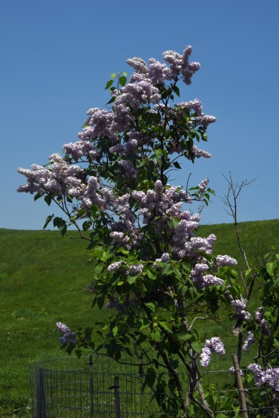
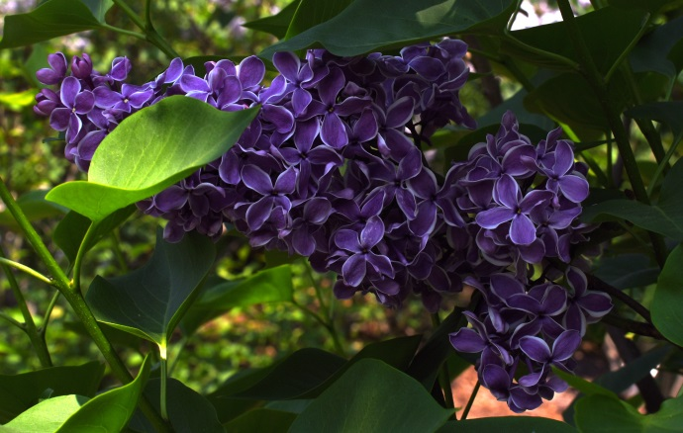
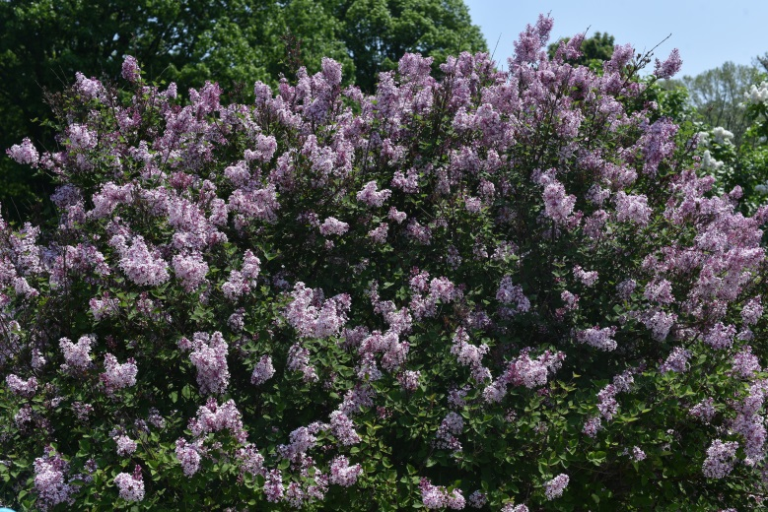
Colophon
These slides were prepared using the Cambria typeface. Mathematical equations use Times New Roman, and source code is presented using Consolas.
The photographs of flowers and a monarch butter appearing on the title slide and accenting the top of each other slide were taken at the Royal Botanical Gardens in October of 2017 by Douglas Wilhelm Harder. Please see
https://www.rbg.ca/
for more information.

Slide 12
Disclaimer
These slides are provided for the ne 112 Linear algebra for nanotechnology engineering course taught at the University of Waterloo. The material in it reflects the authors’ best judgment in light of the information available to them at the time of preparation. Any reliance on these course slides by any party for any other purpose are the responsibility of such parties. The authors accept no responsibility for damages, if any, suffered by any party as a result of decisions made or actions based on these course slides for any other purpose than that for which it was intended.

